Slide 1






LEARNING
THEORIES

Slide 2
OBJECTIVES
  Discuss the operational definition of terms that are directly related to learning;
  Examine the existing learning theories and its applicability to various settings;
  Share our personal understanding of the relevance of learning theories in health education; and,
  Share our personal understanding of the relevance of learning theories in health education; and,

Slide 3


OUTLINE
01
Discuss the operational definition of learning.
02
Examine the 6 learning theories.
03
Delve into the concepts of classical and operational conditioning.
04
Discuss the types and relevance of multiple intelligences.

Slide 4
WHAT IS LEARNING?
“a persisting change in human performance or performance potential . . . (brought) about as a result of the learner’s interaction with the environment”
-(Driscoll, 1994, pp. 8-9).
“the relatively permanent change in a person’s knowledge or behavior due to experience”
-(Mayer, 1982, p. 1040).
“an enduring changein behavior, or in the capacity to behave in a given fashion, which results from practice or other forms of experience”
-(Shuell, 1986, p. 412).

Slide 5

Why is learning important?
Learning is essential to our existence. Just like food nourishes our bodies, information and continued learning nourishes our minds. Lifelong learning is an indispensable tool for every career and organisation.
“The only thing that is constant is change”, Heraclitus.

Slide 6

Benefits of Learning
1. Remain relevant
Don’t be left behind. Ensure you remain relevant to your industry by keeping up to date with trends and adapting your skill set. To function effectively amongst this rapidly changing world of technology, you need to learn new things to remain valuable.
2. Prepare for the unexpected
Lifelong learning will help you adapt to unexpected changes, for example, losing your job and having to depend on new skills to find work. By continuing to learn, you’ll more easily step out of your comfort zone and take on new job opportunities.
3. Boost you profile
When you’re always learning, you’ll keep improving and grow in your career and start to receive recommendations from colleagues and managers. The chances are that you’ll switch jobs multiple times throughout your life and you need to learn new skills to adapt accordingly.

Slide 7
Benefits of Learning
4. Competence leads to confidence
Learning new things gives us a feeling of accomplishment, which in turn boosts our confidence in our own capabilities. Also, you’ll feel more ready to take on challenges and explore new business ventures.
5. Sparks new ideas
Acquiring new skills will unveil new opportunities and help you find innovative solutions to problems. This could earn you more money.
6. Change your perspective
Continuous learning opens your mind and changes your attitude by building on what you already know. The more you learn, the better you’ll get at seeing more sides of the same situation, helping you understand more deeply.
7. Pay it forward
Continuous learning isn’t just about you. Lifelong learning helps develop your leadership skills which then translates into fostering lifelong learning in other individuals, by encouraging them to pursue further education.

Slide 8

Learning
Theory
6 MAIN THEORIES:
  Behaviorism
  Cognitivism
  Social Learning Theory
  Social Constructivism
  Multiple Intelligences
  Brain-Based Learning

Slide 9


Behaviorism
Confined to observable and measurable
behavior
Classical Conditioning - Pavlov
Operant Conditioning - Skinner

Slide 10
IVAN PAVLOV
-Ivan Pavlov was a Russian physiologist best known in psychology for his discovery of classical conditioning. During his studies on the digestive systems of dogs, Pavlov noted that the animals salivated naturally upon the presentation of food.
-However, he also noted that the animals began to salivate whenever they saw the white lab coat of an experimental assistant. It was through this observation that Pavlov discovered that by associating the presentation of food with the lab assistant, a conditioned response occurred.

Slide 11
CLASSICAL CONDITIONING
-A type of unconscious or automatic learning. This learning process creates a conditioned response through associations between an unconditioned stimulus and a neutral stimulus.
(Wolpe, J. & Plaud, J., 1997

Slide 12
01
Unconditioned Stimulus
An unconditioned stimulus is a stimulus or trigger that leads to an automatic response. If a cold breeze makes you shiver, for instance, the cold breeze is an unconditioned stimulus; it produces an involuntary response (the shivering).

Slide 13
02
Neutral Stimulus
A neutral stimulus is a stimulus that doesn't initially trigger a response on its own. If you hear the sound of a fan but don't feel the breeze, for example, it wouldn't necessarily trigger a response. That would make it a neutral stimulus.

Slide 14
03
Conditioned Stimulus
A conditioned stimulus is a stimulus that was once neutral (didn't trigger a response) but now leads to a response. If you previously didn't pay attention to dogs, but then got bit by one, and now you feel fear every time you see a dog, the dog has become a conditioned stimulus.

Slide 15
04
Unconditioned Response
An unconditioned response is an automatic response or a response that occurs without thought when an unconditioned stimulus is present. If you smell your favorite food and your mouth starts watering, the watering is an unconditioned response.

Slide 16
05
Conditioned Response
A conditioned response is a learned response or a response that is created where no response existed before. Going back to the example of being bit by a dog, the fear you experience after the bite is a conditioned response.

Slide 17
B.F. SKINNER
-B. F. Skinner (1904-1990) was an American psychologist known for his impact on behaviorism. In a 2002 survey of psychologists, he was identified as the most influential psychologist of the 20th century.
-B. F. Skinner himself referred to his philosophy as "radical behaviorism." He suggested that the concept of free will was simply an illusion and, instead, believed that all human action was the direct result of conditioning.

Slide 18
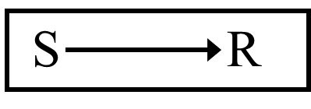
Classical Conditioning
- Pavlov
BEHAVIORISM
A stimulus is presented in order to get a response:

Slide 19
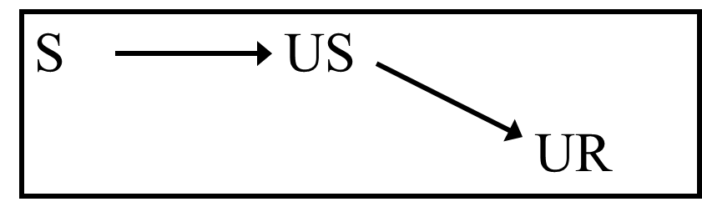

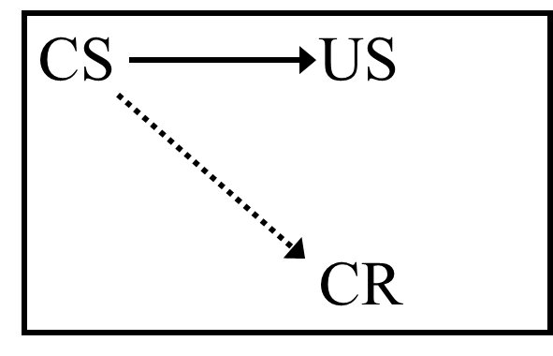

Classical Conditioning
- Pavlov
BEHAVIORISM

Slide 20

Operant Conditioning
- Skinner
The response is made first, then reinforcement follows.
BEHAVIORISM

Slide 21
BEHAVIORISM
  Learning is defined by the outward expression of new behaviors
  Focuses solely on observable behaviors
  A biological basis for learning
  Learning is context-independent
  Classical & Operant Conditioning
–Reflexes (Pavlov’s Dogs)
–Feedback/Reinforcement (Skinner’s Pigeon Box)

Slide 22

Behaviorism in the Classroom
  Rewards and punishments
  Responsibility for student learning rests squarely with the teacher
  Lecture-based, highly structured

Slide 23
CRITIQUES OF BEHAVIORISM
  Does not account for processes taking place in the mind that cannot be observed
  Advocates for passive student learning in a teacher-centric environment
  One size fits all
  Knowledge itself is given and absolute
  Programmed instruction & teacher-proofing

Slide 24

LEARNING THEORY
  Behaviorism
  Cognitive Learning Theory
  Social Learning Theory

Slide 25
COGNITIVISM
  Grew in response to Behaviorism
  Knowledge is stored cognitively as symbols
  Learning is the process of connecting symbols in a meaningful & memorable way
  Studies focused on the mental processes that facilitate symbol connection

Slide 26
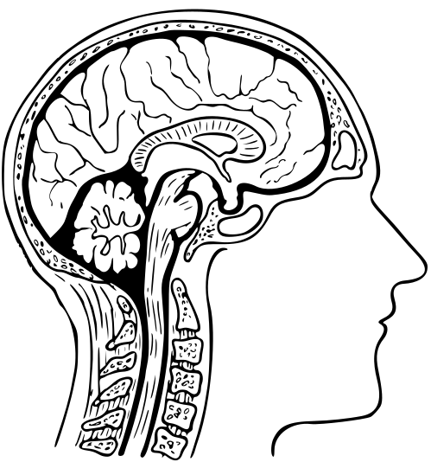
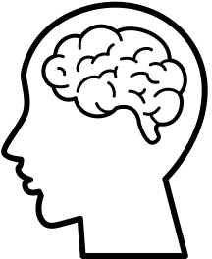
COGNITIVE
LEARNING
THEORY
  Discovery Learning - Jerome Bruner
  Meaningful Verbal Learning - David Ausubel

Slide 27


DISCOVERY LEARNING
-Bruner said anybody can learn anything at any age, provided it is stated in terms they can understand.
COGNITIVE
LEARNING
THEORY

Slide 28
DISCOVERY LEARNING
2. Powerful Concepts (not isolated facts)
  Transfer to many different situations
  Only possible through Discovery Learning
  Confront the learner with problems and help them find solutions. Do not present sequenced materials.
COGNITIVE
LEARNING
THEORY

Slide 29

MEANINGFUL VERBAL LEARNING
Advance Organizers:
  New material is presented in a systematic way, and is connected to existing cognitive structures in a meaningful way.
COGNITIVE
LEARNING
THEORY

Slide 30
MEANINGFUL VERBAL LEARNING
Advance Organizers:
  When learners have difficulty with new material, go back to the concrete anchors (Advance Organizers). Provide a Discovery approach, and they’ll learn.
COGNITIVE
LEARNING
THEORY

Slide 31

Cognitivism in the Classroom
  Inquiry-oriented projects
  Opportunities for the testing of hypotheses
  Curiosity encouraged
  Staged scaffolding

Slide 32
CRITIQUES OF COGNITIVISM
  Like Behaviorism, knowledge itself is given and absolute
  Input – Process – Output model is mechanistic and deterministic
  Does not account enough for individuality
  Little emphasis on affective characteristics

Slide 33
LEARNING THEORY
  Like Behaviorism, knowledge itself is given and absolute
  Input – Process – Output model is mechanistic and deterministic
  Does not account enough for individuality
  Little emphasis on affective characteristics

Slide 34

Learning Theory
  Behaviorism
  Social Learning Theory
  Cognitive Learning Theory

Slide 35
SOCIAL LEARNING THEORY (SLT)
  Grew out of Cognitivism
  A. Bandura (1973)
  Learning takes place through observation and sensorial experiences
  Imitation is the sincerest form of flattery
  SLT is the basis of the movement against violence in media & video games

Slide 36

Social Learning Theory
Learning From Models -Albert Bandura
Attend to pertinent clues
Code for memory (store a visual image)
Retain in memory
Accurately reproduce the observed activity
Possess sufficient motivation to apply new learning

Slide 37
Social Learning Theory
Research indicates that the following factors influence the strength of learning from models:
1. How much power the model seems to have
2. How capable the model seems to be
3. How nurturing (caring) the model seems to be
4. How similar the learner perceives self and model
5. How many models the learner observes

Slide 38

Social Learning Theory
Four interrelated processes establish and strengthen identification with the model:
1. Children want to be like the model
2. Children believe they are like the model
3. Children experience emotions like those the model is feeling.
4. Children act like the model.

Slide 39
Social Learning Theory
  Through identification, children come to believe they have the same characteristics as the model.
  When they identify with a nurturant and competent model, children feel pleased and proud.
  When they identify with an inadequate model, children feel unhappy and insecure.

Slide 40

SOCIAL LEARNING THEORY
IN THE CLASSROOM
  Collaborative learning and group work
  Modeling responses and expectations
  Opportunities to observe experts in action

Slide 41
CRITIQUES OF SOCIAL LEARNING THEORY
  Does not take into account individuality, context, and experience as mediating factors
  Suggests students learn best as passive receivers of sensory stimuli, as opposed to being active learners
  Emotions and motivation not considered important or connected to learning

Slide 42

SOCIAL CONSTRUCTIVISM
  Journaling
  Experiential activities
  Personal focus
  Collaborative & cooperative learning
  Suggests that knowledge is neither given nor absolute
  Often seen as less rigorous than traditional approaches to instruction
  Does not fit well with traditional age grouping and rigid terms/semesters

Slide 43

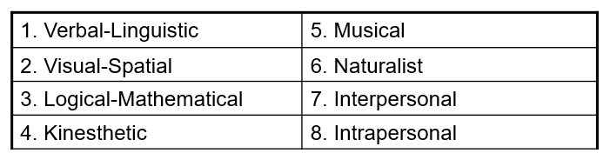
Multiple Intelligences (MI)
  Grew out of Constructivism, framed around metacognition
  H. Gardner (1983 to present)
  All people are born with eight intelligences:
  Enables students to leverage their strengths and purposefully target and develop their weaknesses

Slide 44
HOWARD GARDNER
  Gardner (2013) asserts that regardless of which subject you teach—“the arts, the sciences, history, or math”—you should present learning materials in multiple ways. Gardner goes on to point out that anything you are deeply familiar with “you can describe and convey … in several ways. We teachers discover that sometimes our own mastery of a topic is tenuous, when a student asks us to convey the knowledge in another way and we are stumped.” Thus, conveying information in multiple ways not only helps students learn the material, it also helps educators increase and reinforce our mastery of the content.

Slide 45
HOWARD GARDNER
  The theory of multiple intelligences was developed in 1983 by Dr. Howard Gardner, professor of education at Harvard University. It suggests that the traditional notion of intelligence, based on I.Q. testing, is far too limited. Instead, Dr. Gardner proposes eight different intelligences to account for a broader range of human potential in children and adults.

Slide 46
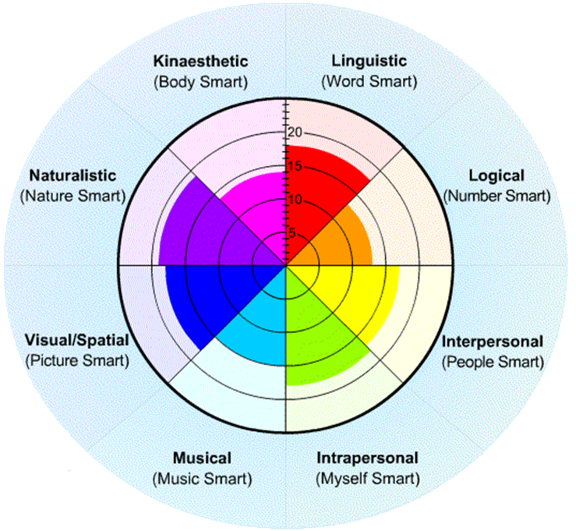
Multiple Intelligences (MI)
  Delivery of instruction via multiple mediums
  Student-centered classroom
  Authentic Assessment
  Self-directed learning

Slide 47
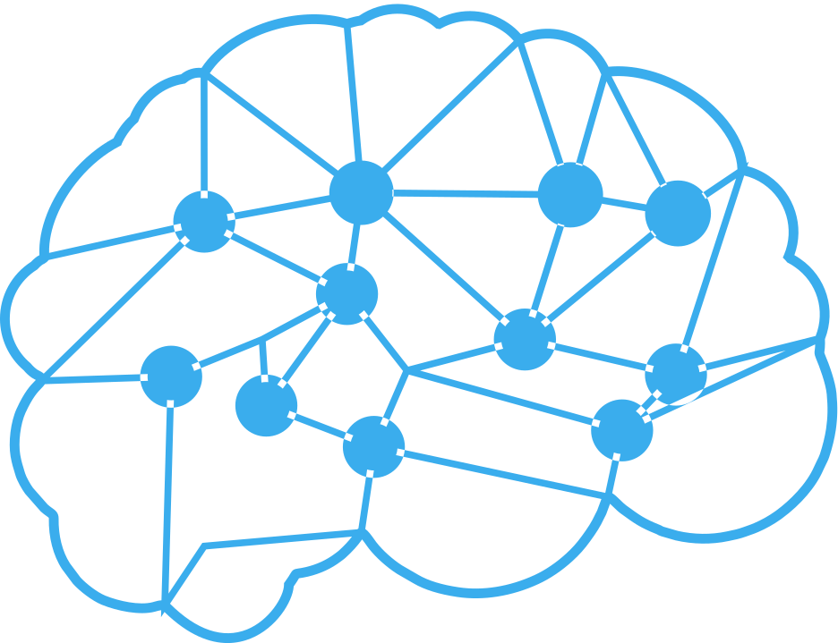
MULTIPLE INTELLIGENCES (MI)
1.Linguistic intelligence (“word smart”)
2.Logical-mathematical intelligence (“number/reasoning smart”)
3.Spatial intelligence (“picture smart”)
4.Bodily-Kinesthetic intelligence (“body smart”)
5.Musical intelligence (“music smart”)
6.Interpersonal intelligence (“people smart”)
7.Intrapersonal intelligence (“self smart”)
8.Naturalist intelligence (“nature smart”)

Slide 48

CRITIQUES OF MULTIPLE INTELLIGENCE
  Lack of quantifiable evidence that MI exist
  Lack of evidence that use of MI as a curricular and methodological approach has any discernable impact on learning
  Suggestive of a departure from core curricula and standards

Slide 49
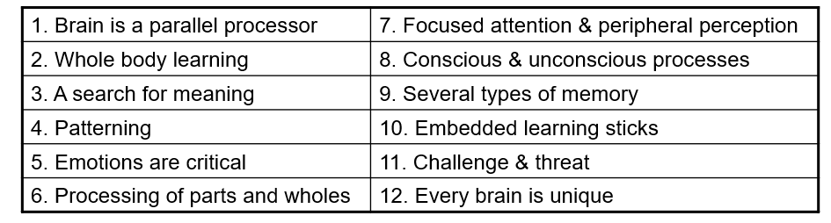
Brain-Based Learning (BBL)
  Grew out of Neuroscience & Constructivism
  D. Souza, N. Caine & G. Caine, E. Jensen (1980’s to present)
  12 governing principles

Slide 50
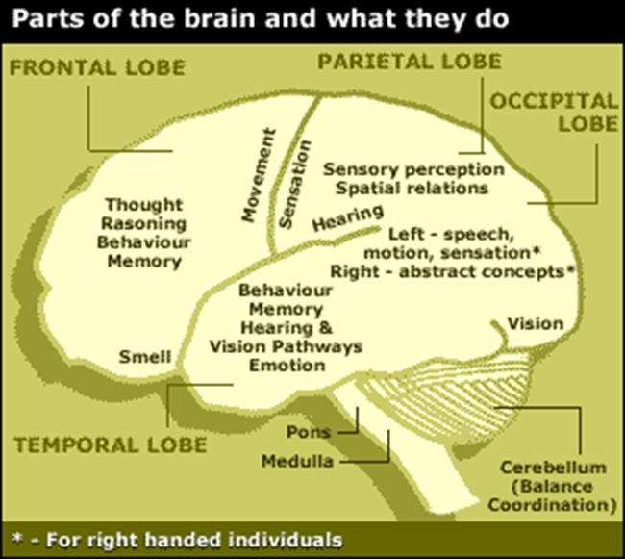
Brain-Based Learning (BBL)
  Opportunities for group learning
  Regular environmental changes
  A multi-sensory environment
  Opportunities for self-expression and making personal connections to content
  Community-based learning

Slide 51
CRITIQUES OF BBL
  Research conducted by neuroscientists, not teachers & educational researchers
  Lack of understanding of the brain itself makes “brain-based” learning questionable
  Individual principles have been scientifically questioned

Slide 52
OTHER LEARNING
THEORIES OF NOTE
  Andragogy (M. Knowles)
  Flow (M. Czikszentmihalyi)
  Situated Learning (J. Lave)
  Subsumption Theory (D. Ausubel)
  Conditions of Learning (R. Gagne)

Slide 53
HUMANIST
  All students are intrinsically motivated to self actualize or learn
  Learning is dependent upon meeting a hierarchy of needs (physiological, psychological and intellectual)
  Learning should be reinforced.

Slide 54
REFERENCES
  Cherry, K. (2022). What is Operant Conditioning? How Reinforcement and Punishment Modify Behavior. Verywellmind. Behavioral Psychology
  Cherry, K. (2022). B.F. Skinner’s Life, Theories, and Psychology. Skinner studied operant conditioning and believed in radical behaviorism. Verywellmind. History and Biographies
  Wolpe J, Plaud JJ. Pavlov's contributions to behavior therapy. The obvious and not so obvious. Am Psychol. 1997;52(9):966-72.
  Bhasin, H. (2019). What is the Importance of Learning (In Any Stage of Life). Marketing91
  Armstrong, T. (n.d.). Multiple Intelligences. American Institute for Learning and Human Development. institute4learning

Slide 55

Logo Here
THANK
YOU

